Slide 1
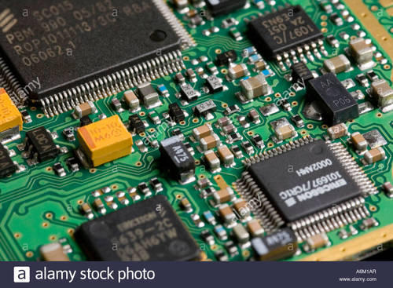
Lab Notebook for EECT 211 By: Alex Drummond My Lab Partners were Jarred Clark and Seth Wills

Slide 2
Lab 11: RC Lab Lab Partners were Jarred Clark and Seth Wills
The Purpose of this lab is to redo lab 11 from EECT 111 but using elvis by experimenting with resistors and capacitors.
By measuring the input and output voltages using an oscilloscope.
Equipment needed:
1 – Digital Multimeter 1 – Function Generator
1 – Elvis II 3 – capacitors
1 – resistor 1 – LCR Meter
1 – Oscilloscope

Slide 3
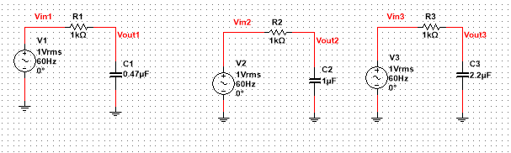
Lab 11
This is the multisim simulation for Lab 11

Slide 4
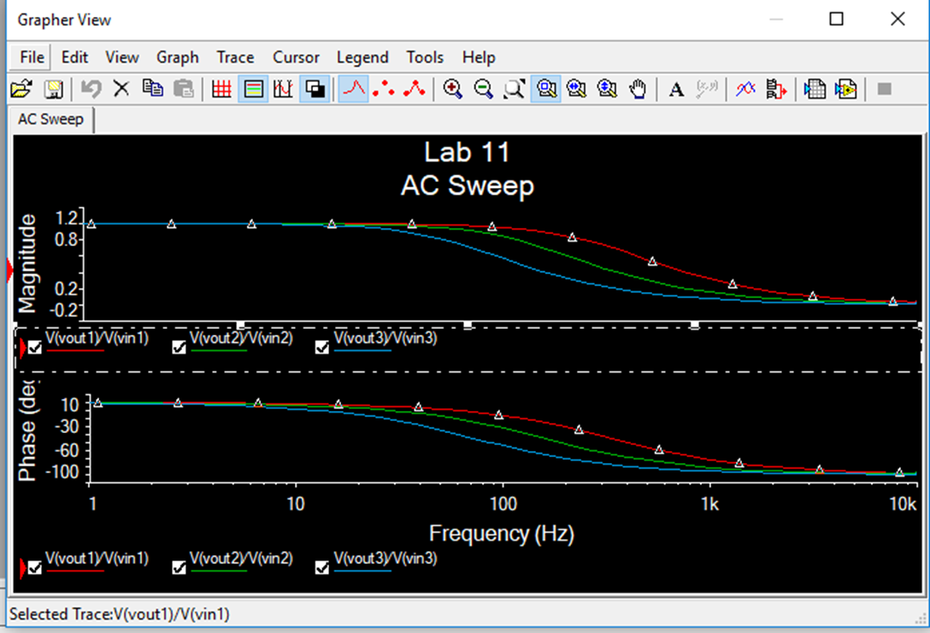
Lab 11
This is the multisim Ac sweep reading for each of the schematics

Slide 5
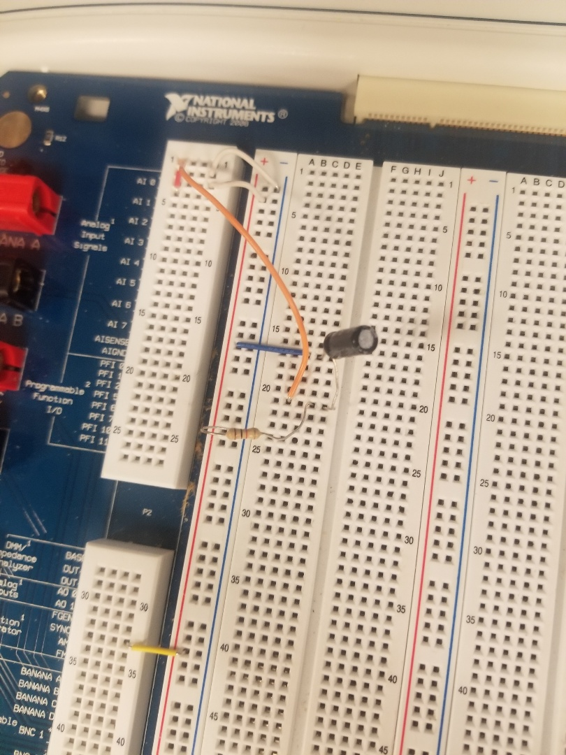
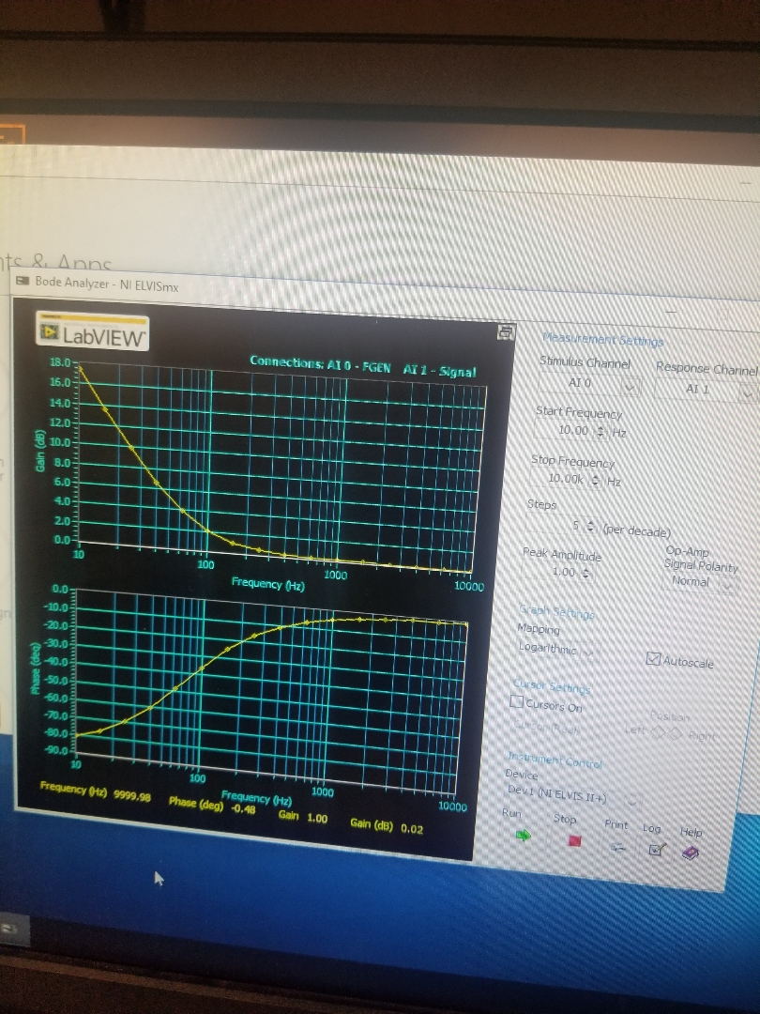
Lab 11
This is a picture of our circuit for one of the capacitors and the reading of the bode analyzer

Slide 6
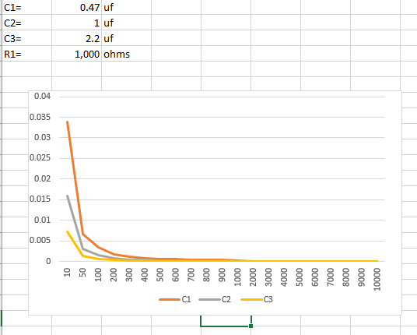
Lab 11
This is the Excel Spreadsheet for Lab 11
Lab 11 Excel Spreadsheet

Slide 7
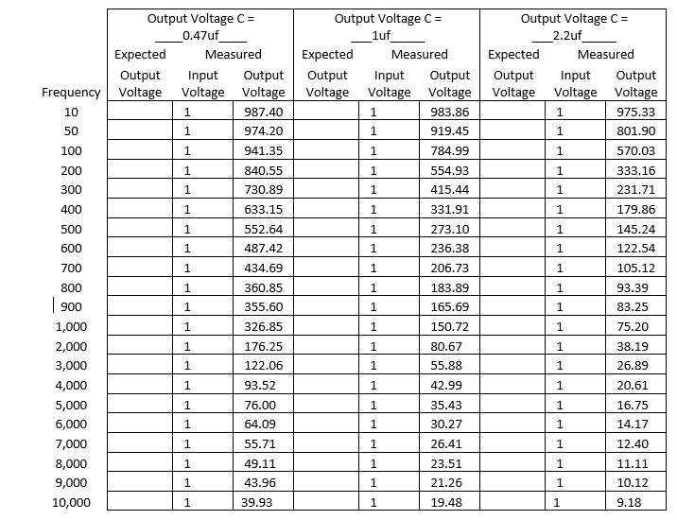
Lab 11
This is each reading for different frequencies for each desired circuit with a different capacitor

Slide 8
Lab 11
Observations: when using a higher valued capacitance capacitor the smaller the output voltage will be and the resistance stayed the same throughout the process. With the higher capacitor, the drop off is more at the same frequency. With the lower capacitor, the drop off is less at the same frequency.

Slide 9
Lab 11-2: RC but switching the resistor and capacitor Lab Partners were Seth Wills and Jarred Clark
The Purpose of this lab is to redo lab 11 from EECT 111 but using elvis and switching the resistors and capacitors location in the desired circuit by experimenting with resistors and capacitors.
By measuring the input and output voltages using an oscilloscope.
Equipment needed:
1 – Digital Multimeter 1 – Function Generator
1 – Elvis II 3 – capacitors
1 – resistor 1 – LCR Meter
1 – Oscilloscope

Slide 10
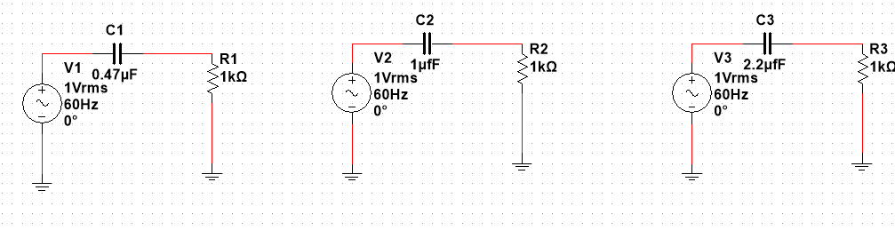
Lab 11-2
This is the multisim simulation for lab 11 but switching the resistor and capacitors location

Slide 11
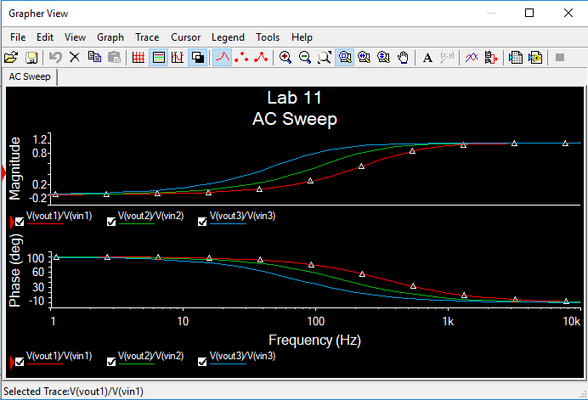
Lab 11-2
This is the multisim ac sweep reading with both components switched

Slide 12
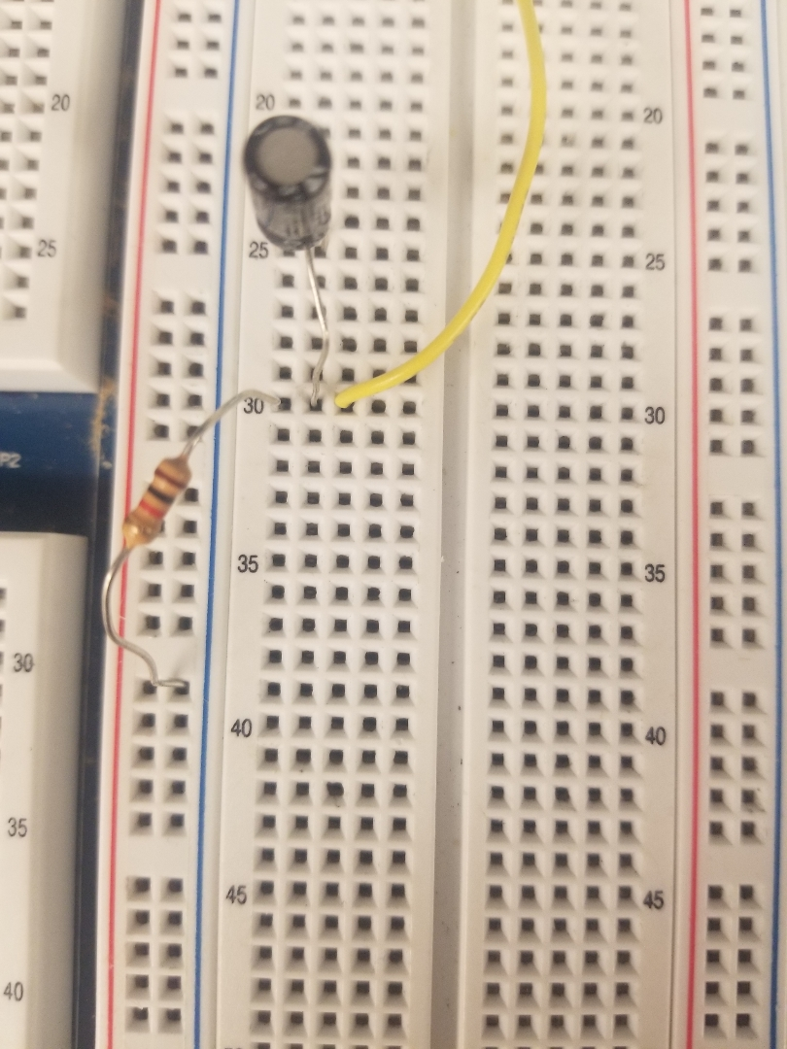

Lab 11-2
This is the picture of the circuit with components switched

Slide 13
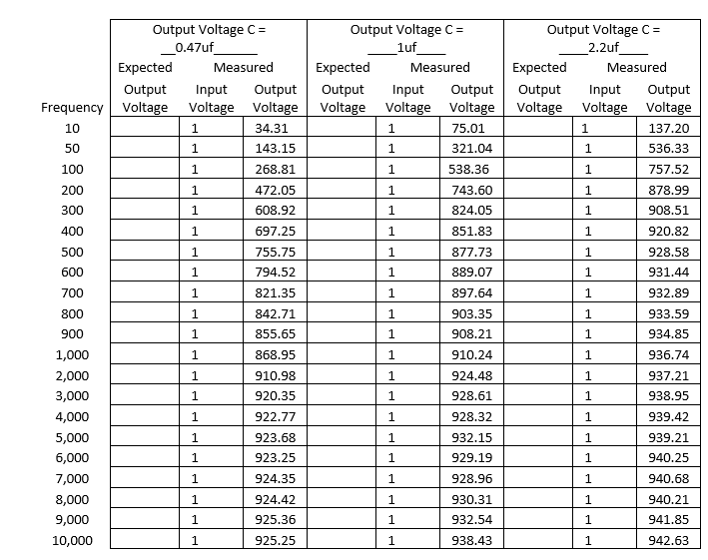
Lab 11-2
This is each reading for different frequencies for each desired circuit with a different capacitor and the components switched

Slide 14
11-2
Observations: when using a higher capacitance capacitor the output voltage increased. The resistance stayed the same throughout the process. Doing the lab with the components switched from lab 11 the outputs were completely switched.

Slide 15
Lab 13: RL Lab Lab Partners were Jarred Clark and Seth Wills
The Purpose of this lab is to redo lab 13 from EECT 111 but using elvis by experimenting with resistors and indcutors.
By measuring the input and output voltages using an oscilloscope.
Equipment needed:
1 – Digital Multimeter 1 – Function Generator
1 – Elvis II 3 – inductors
1 – resistor, 100 ohm 1 – LCR Meter
1 – Oscilloscope

Slide 16
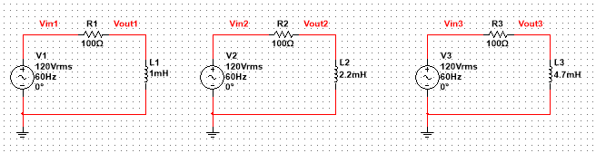
Lab 13
This is our multisim simulations for lab 13 using an 100 ohm resistor and three different inductors

Slide 17
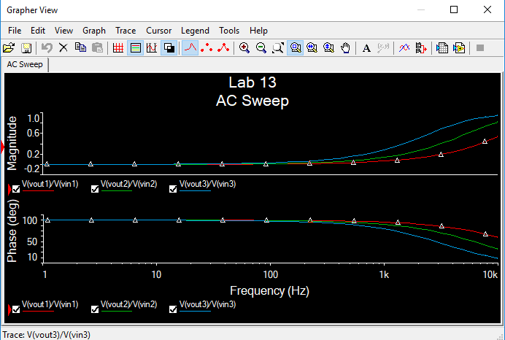
Lab 13
This is our multisim Ac sweep reading the inputs and outputs to each circuit with a different inductor

Slide 18
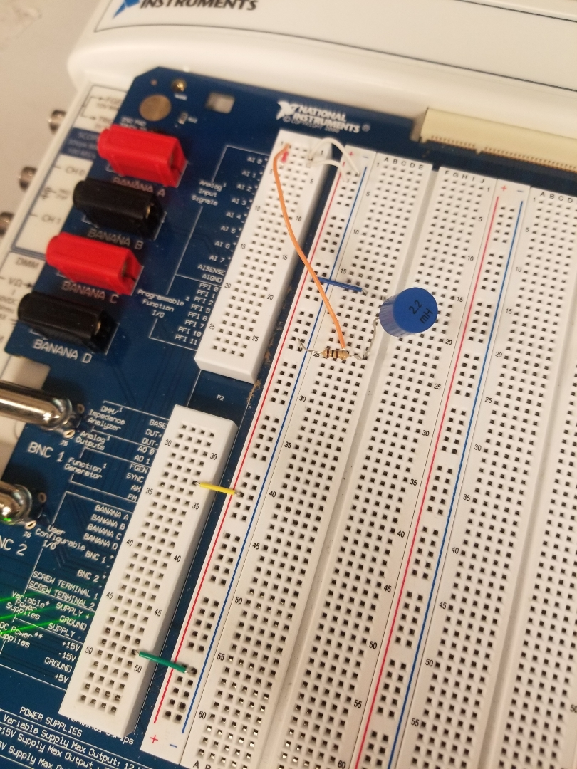
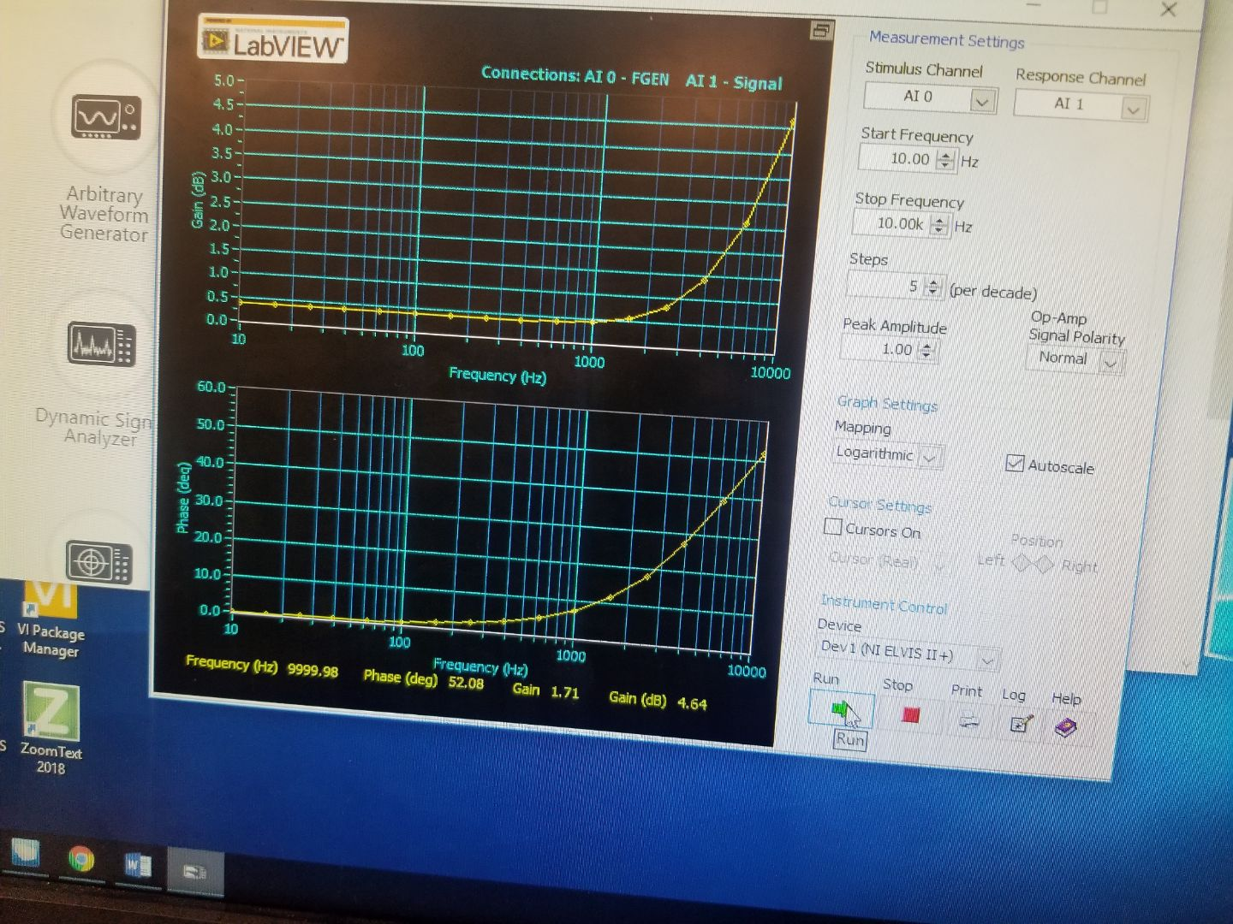
Lab 13
This is a picture of our circuit for one of the inductors and the reading of the bode analyzer

Slide 19
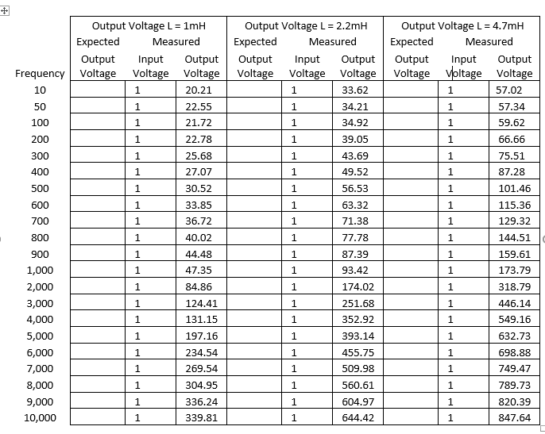
Lab 13
This is each reading for different frequencies for each desired circuit with a different inductor

Slide 20
Lab 13
Observations: the bigger the inductor the higher the output voltage will be and the resistance stayed the same throughout the process.

Slide 21
Lab 13-2: RL Lab but switching the inductor and the resistors location Lab Partners were Seth Wills and Jarred Clark
The Purpose of this lab is to redo lab 13 from EECT 111 but using elvis by experimenting with resistors and capacitors but switching both components location.
By measuring the input and output voltages using an oscilloscope.
Equipment needed:
1 – Digital Multimeter 1 – Function Generator
1 – Elvis II 3 – inductors
1 – resistor 1 – LCR Meter
1 – Oscilloscope

Slide 22
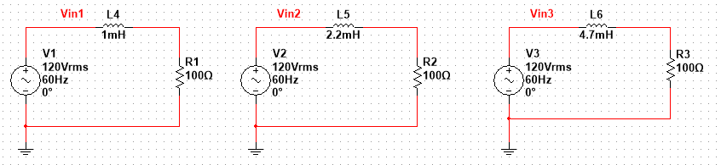
Lab 13-2
This is our multisim simulations for lab 13 using an 100 ohm resistor and three different inductors but switching the components location

Slide 23
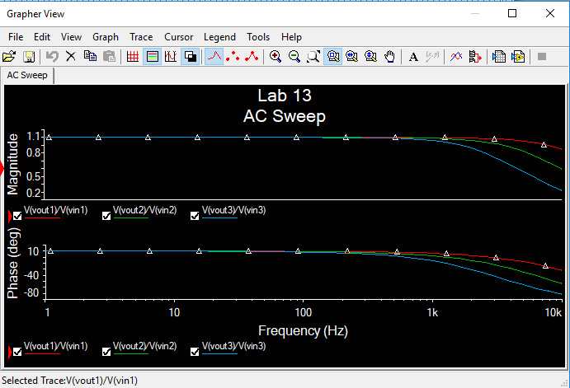
Lab 13-2
This is the multisim ac sweep for each desired circuit with the components switched

Slide 24
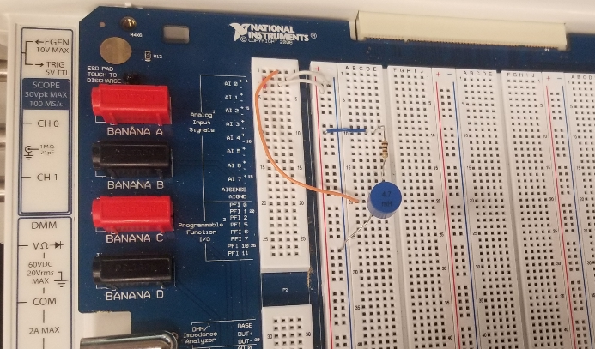
Lab 13-2
This is the picture of the circuit with components switched

Slide 25
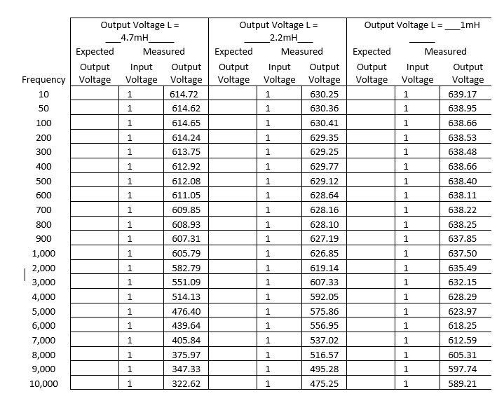
Lab 13-2
This is each reading for different frequencies for each desired circuit with a different inductor with the inductor and resistor in a different location

Slide 26
Lab 13-2
Observations: The bigger the inductor the higher the output voltage will be and the resistance stayed the same throughout the process. The outputs were completely switched when the inductors and the resistors are switched in the circuit

Slide 27

Lab 14: RC Time Constant Lab Lab Partners were Jarred Clark and Seth Wills
The Purpose of lab 14 is to Experiment with RC (Resistor & Capacitor) circuits and then run a RC time constant on the circuit.
We had to Adjust the voltage of the Function Generator to 1V square wave and 1Hz frequency
Equipment needed:
1 – Digital Multimeter
1 – LCR Meter
1 – Oscilloscope
1 – Function Generator
1 – Elvis II
1 – 47 uF capacitor
1 – 1Kohm resistor
This is the Rc time constant equation

Slide 28
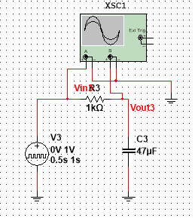
Lab 14
This is the RC Time Constant circuit schematic on multisim connected to an oscilloscope to get the measurements

Slide 29
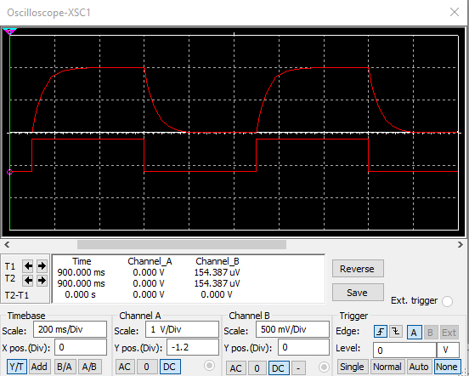
Lab 14
This is the oscilloscope measurement for multisim measuring the time constant between the input and the outputs

Slide 30
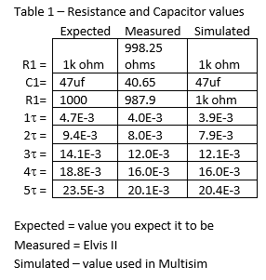
Lab 14
Lab 14 Excel Spreadsheet
This is the excel spreadsheet calculations
This is the simulated and actual measurements of each component

Slide 31
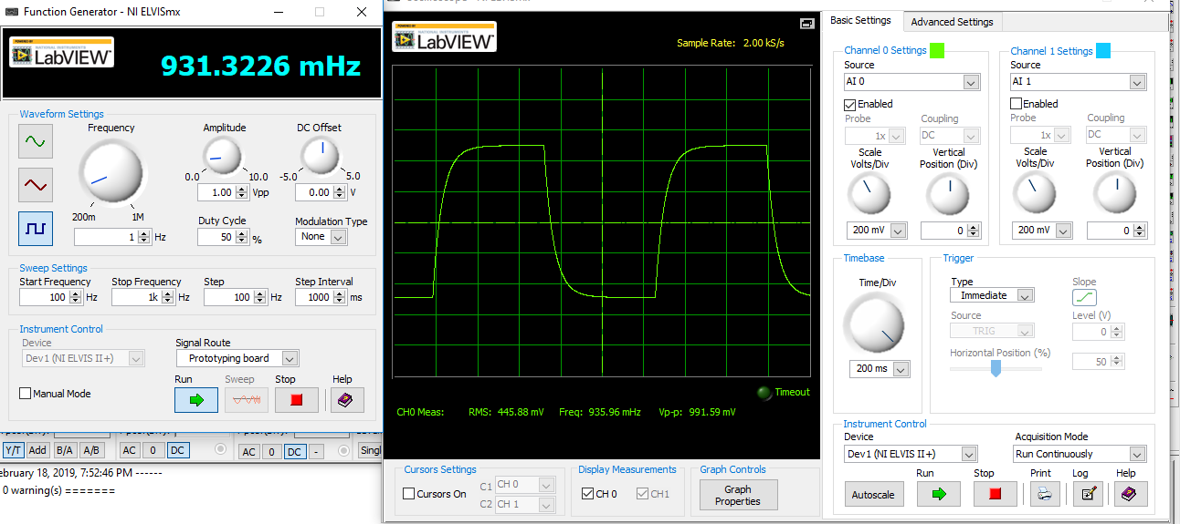
Lab 14
This a picture of the function generator and the oscilloscope using elvis and it is the output of the square wave in order to measure the RC Time Constant

Slide 32
Lab 14
Observations: Time constants are measured in 5 time constants. At the 5th time constant the capacitor is fully charged. The output voltage is the same as the input voltage. Which is considered the Steady State. To calculate all the time constant you use the equation τ = R * C. To calculate all the time constant 2-5 you add the numbers in front of the R in the equation.

Slide 33
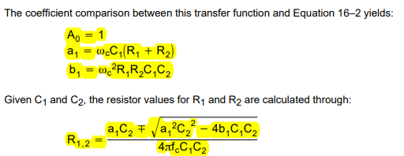
Active Low Pass Filter Lab Partners were Jarred Clark and Seth Wills
The purpose of this lab is to calculate the measurements and design and build the second order low pass filter.
Equipment Needed:
2- capacitors
2- resistors
Elvis II
LM 741
These are the equations we used to calculate the following measurements

Slide 34
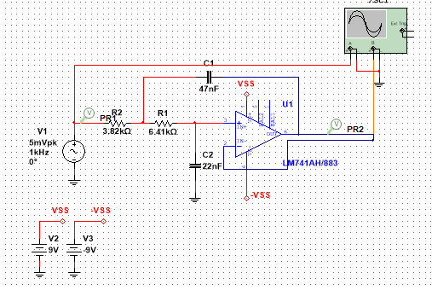
Active Low pass Filter
This is our multisim schematic for the Active Low Pass Filter

Slide 35
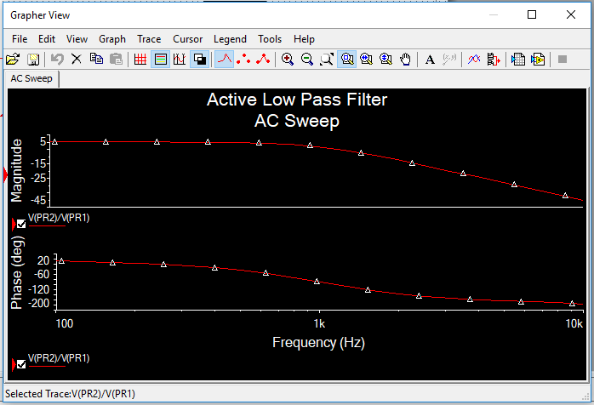
Active Low pass Filter
This is the AC Sweep for the out put of the Active Low Pass Filter

Slide 36
Active Low pass Filter
Spreadsheet
This is the excel spreadsheet calculations for the low pass filter

Slide 37
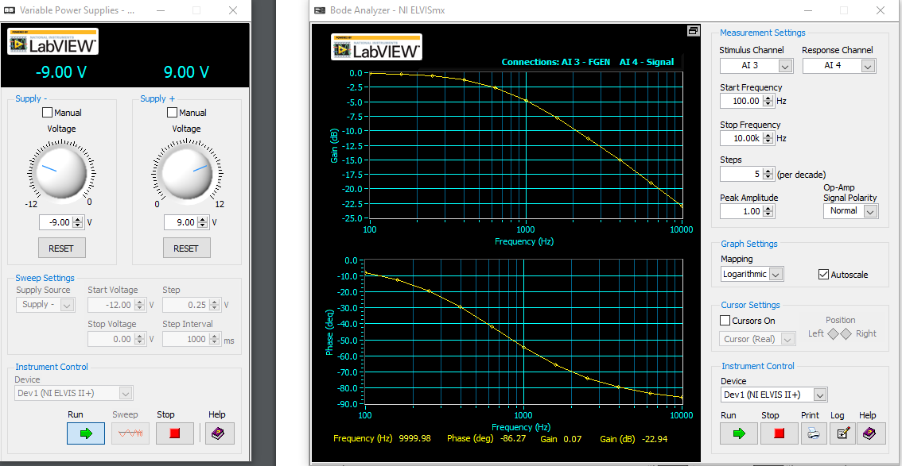
Active Low Pass Filter
This is the Elvis reading using a variable power supply and the bode analyzer and the reading from the output of the low pass filter

Slide 38
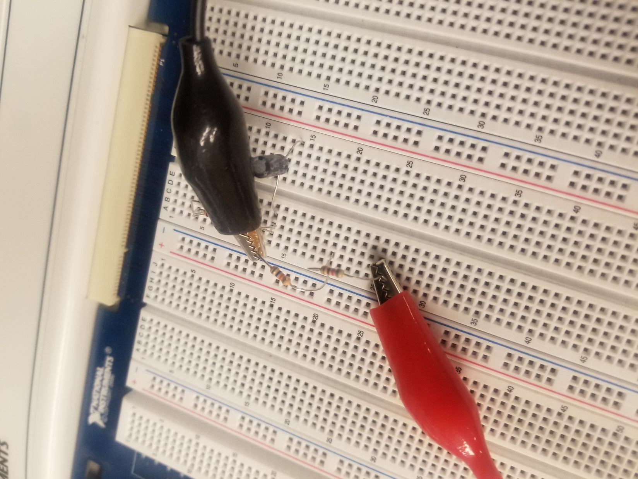
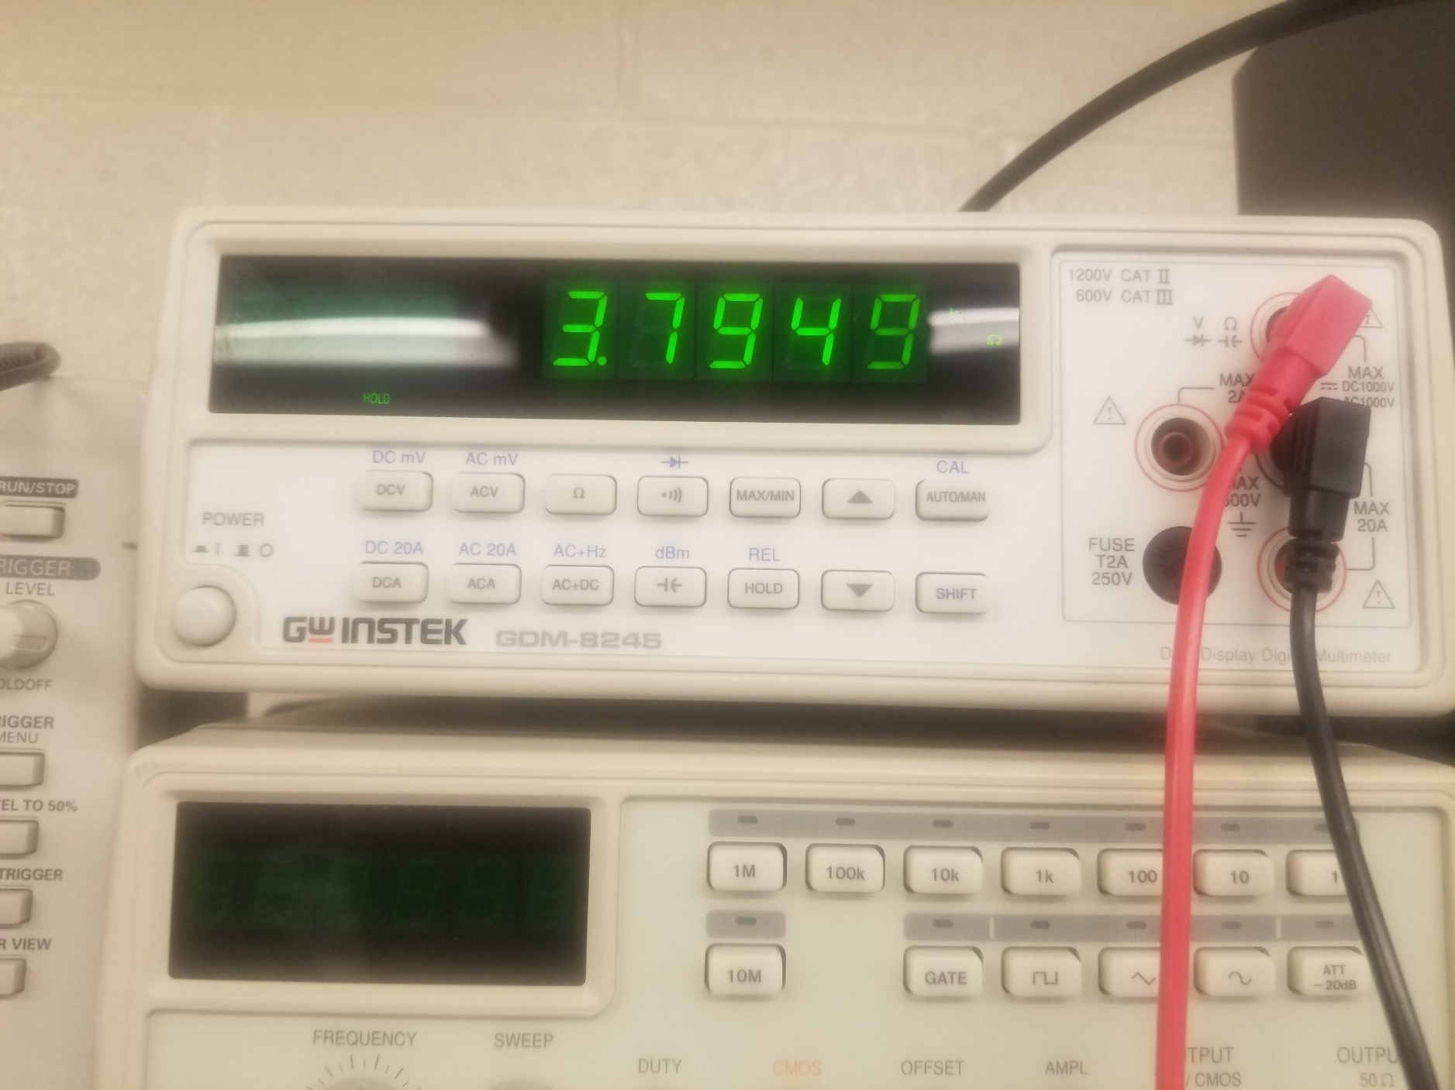
Active Low Pass Filter
These are pictures of measuring the resistance on Elvis and the resister reading, the resister value was uncommon so we had to come up with two resistors to equal that value

Slide 39
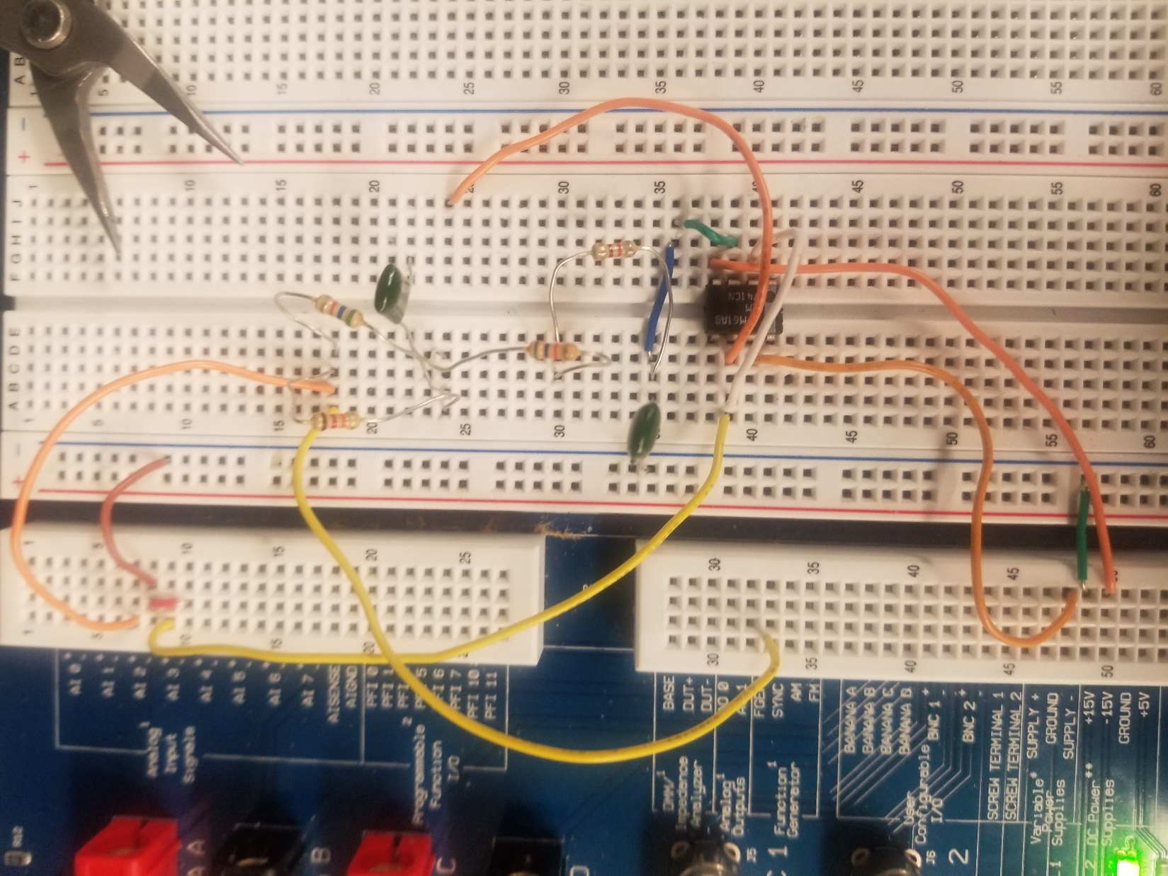
Active Low Pass Filter
This is our circuit for the Active Low Pass Filter

Slide 40
Active Low Pass Filter
Observations: In an active low pass filter. The filter is active at a low frequency and not active at a high frequency. That is why it is called a LOW pass filter.

Slide 41
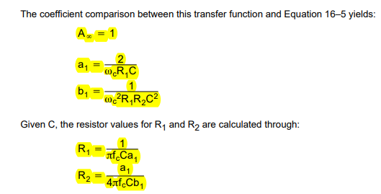
Active High Pass Filter Lab Partners were Jarred Clark and Seth Wills
The purpose of this lab is to calculate the measurements and design and build the second order high pass filter.
Equipment Needed:
2- capacitors
2- resistors
Elvis II
LM 741
These are the equations we used

Slide 42
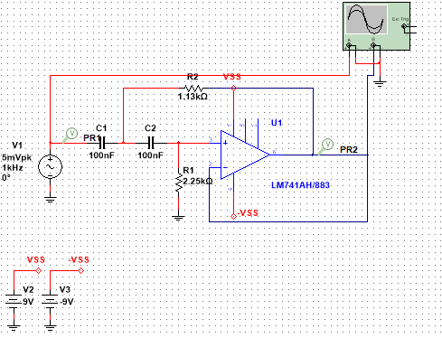
Active High Pass Filter
This is our multi-sim schematic for the Active High Pass Filter

Slide 43
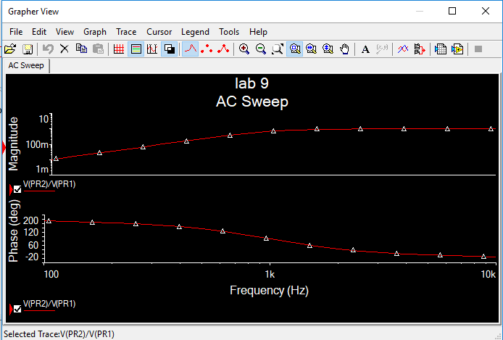
Active High Pass Filter
This is the AC Sweep for the out put of the Active High Pass Filter

Slide 44
Active High Pass Filter
Spreadsheet
HIGH PASS FILTER
A0= | 1
a1= | 1.4142
b1= | 1
C= | 100.0E-9
C1= | 100.0E-9
C2= | 100.0E-9
R1= | 2.3E+3
R2= | 1.1E+3
fc= | 1.0E+3 | Hz
This is the excel spreadsheet calculations for the high pass filter

Slide 45
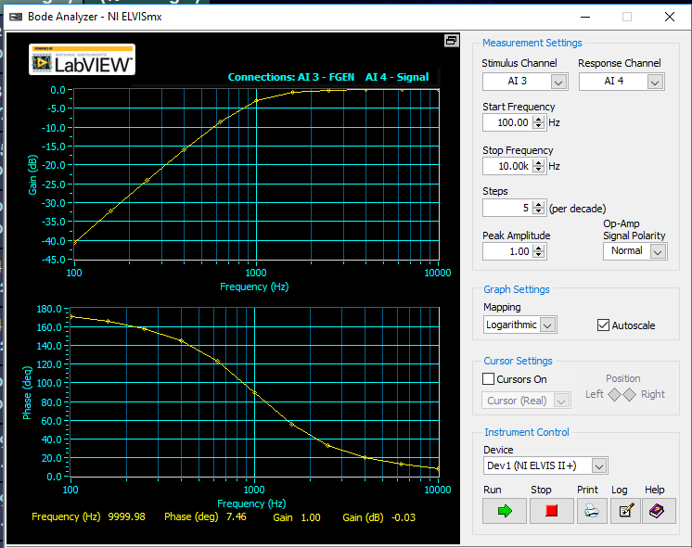
Active High Pass Filter
This is the Elvis reading using a variable power supply and the bode analyzer and the reading from the output of the High pass filter

Slide 46
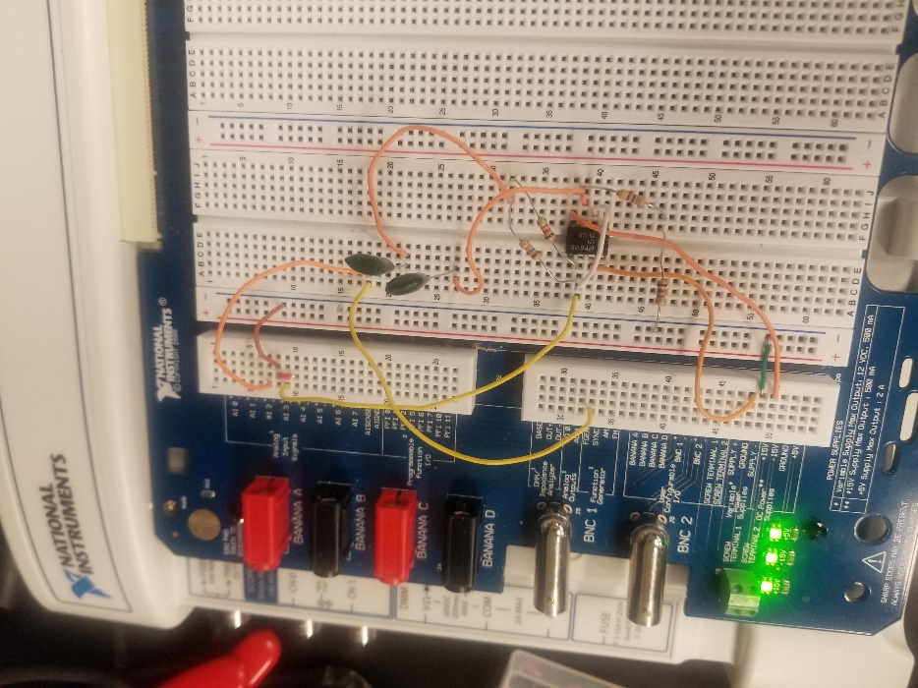
Active High Pass Filter
This is our circuit for the Active High Pass Filter

Slide 47
Active High Pass Filter
Observations: In an active high pass filter. The filter is active at a high frequency and not active at a low frequency. That is why it is called a HIGH pass filter.

Slide 48
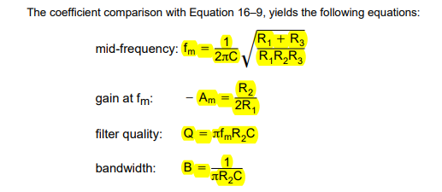
Active Multiple Feedback Topology Filter lab partners were Jarred Clark and Seth Wills
The purpose of this lab is to calculate the measurements and design and build the second order high pass filter.
Equipment Needed:
2- capacitors
3- resistors
Elvis II
LM 741
These are the calculations we used.

Slide 49
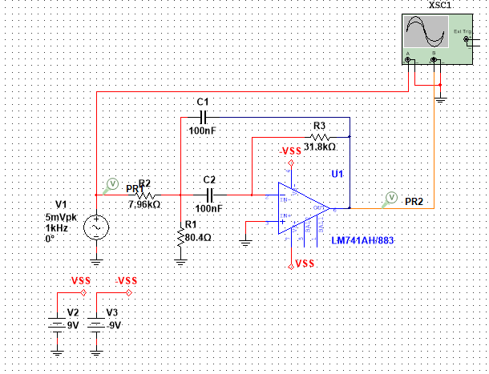
Active Multiple Feedback Topology Filter
This is our multisim schematic for the
Active Multiple Feedback Topology Filter

Slide 50
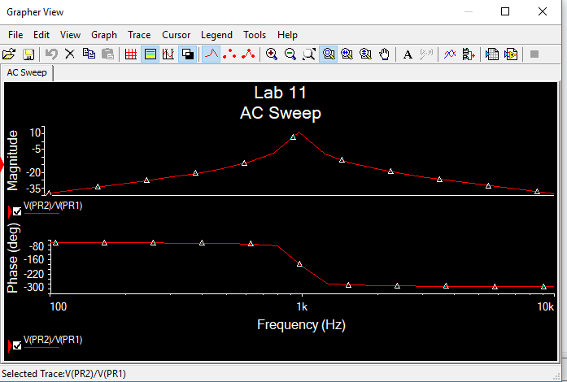
Active Multiple Feedback Topology Filter
This is the AC Sweep for the out put of the Active Multiple Feedback Topology Filter

Slide 51
Active Multiple Feedback Topology Filter
Spreadsheet
This is the excel spreadsheet calculations for the
Active Multiple Feedback Topology Filter

Slide 52
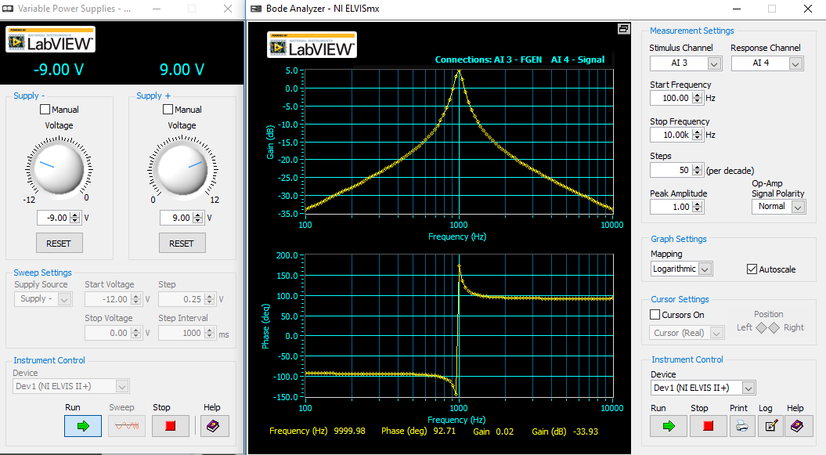
Active Multiple Feedback Topology Filter
This is the Elvis reading using a variable power supply and the bode analyzer and the reading from the output of the Active Multiple Feedback Topology Filter

Slide 53
Active Multiple Feedback Topology Filter
Observations: The filter increases up to a certain range of frequency then decreases after hitting that certain range.

Slide 54
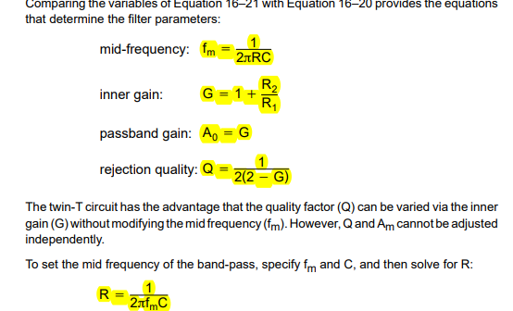
Active Twin-T Filter Lab Partners were Seth Wills and Jarred Clark
The purpose of this lab is to calculate the measurements and design and build the Active Twin-T Filter
Equipment Needed:
2- capacitors
3- resistors
Elvis II
LM 741
These are our equations used

Slide 55
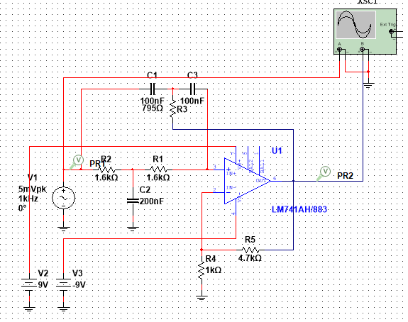
Active Twin-T Filter
This is our multisim schematic for the Active Twin-T Filter

Slide 56
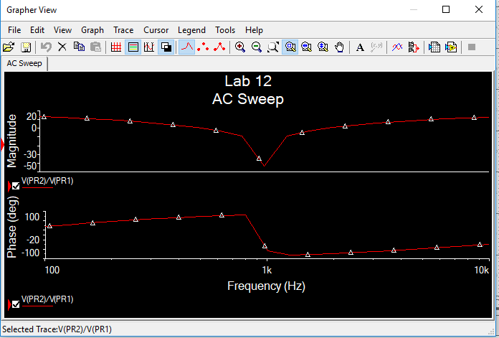
Active Twin-T Filter
This is the AC Sweep for the out put of the Active Twin-T Filter

Slide 57
Active Twin-T Filter
Spreadsheet
This is the excel spreadsheet calculations for the Active Twin-T Filter

Slide 58
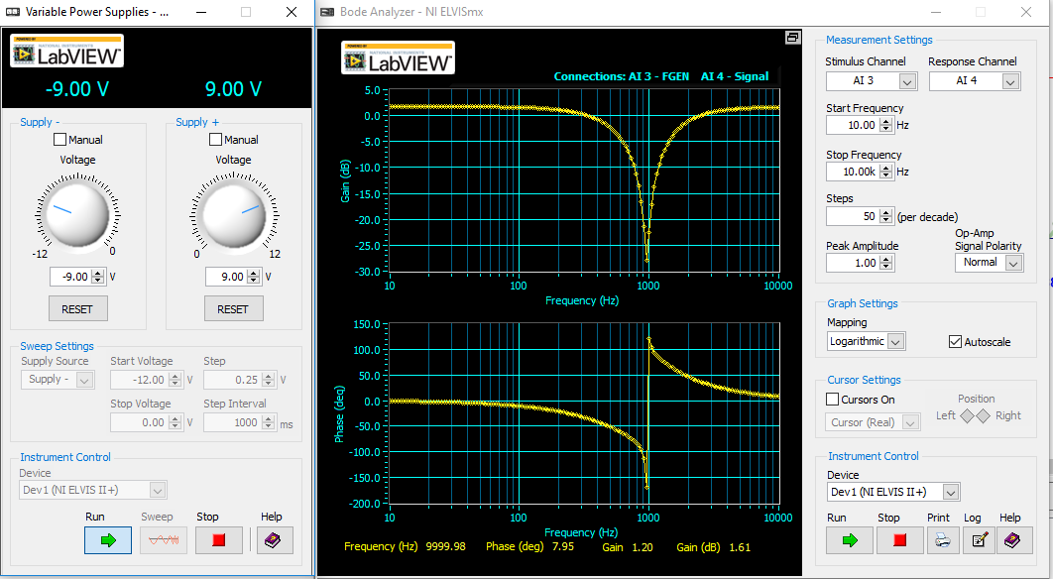
Active Twin-T Filter
This is the Elvis reading using a variable power supply and the bode analyzer and the reading from the output of the Active Twin-T Filter

Slide 59
Active Twin-T Filter
Observations: The active twin filter acts like a notch filter. That rejects a predetermined frequency depending on the application. Then after the rejected frequency it stays active

Slide 60
Op Amp Band Pass Filter lab partners where Jarred Clark and Seth Wills
This Purpose of this lab is to build an Op Amp Band Pass Filter while using elvis II and also using the functions for elvis II.
Equipment Needed:
Elvis II
10k ohm Resistor
100k ohm Resistor
1uf Capacitor
.01uf Capacitor
LM 741

Slide 61
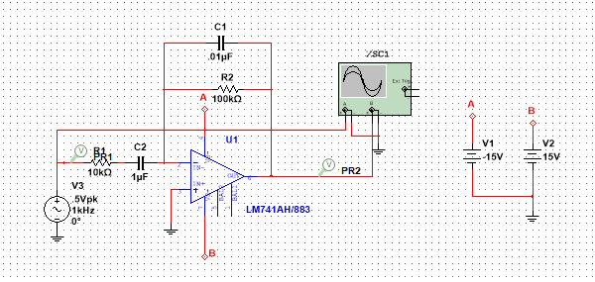
Op Amp Band Pass Filter
This is our multisim schematic for the Op Amp Band Pass Filter

Slide 62
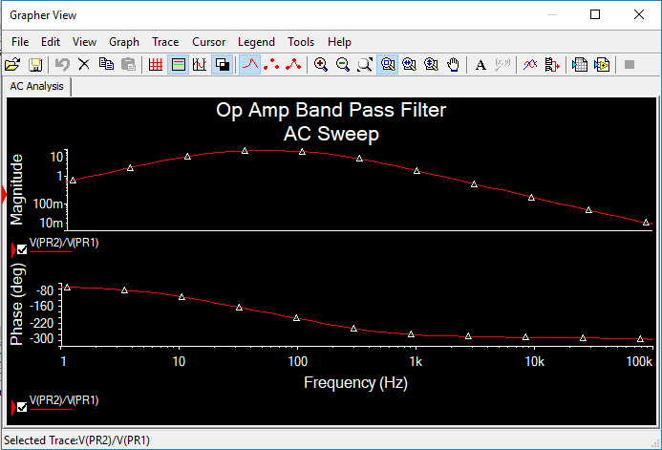
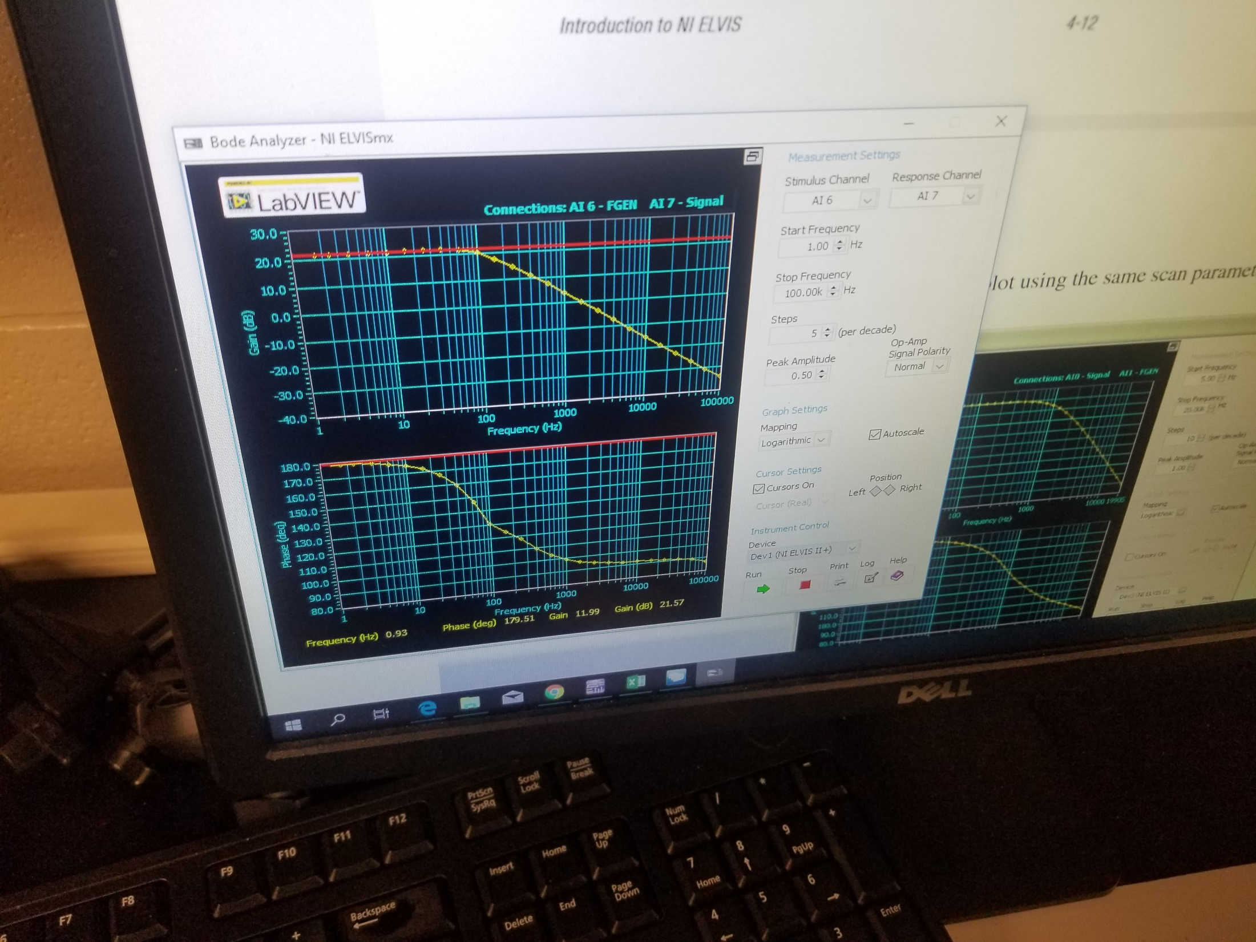
Op Amp Band Pass Filter
These are our pictures for the ac sweep and the bode analyzer readings for Elvis and Multisim

Slide 63
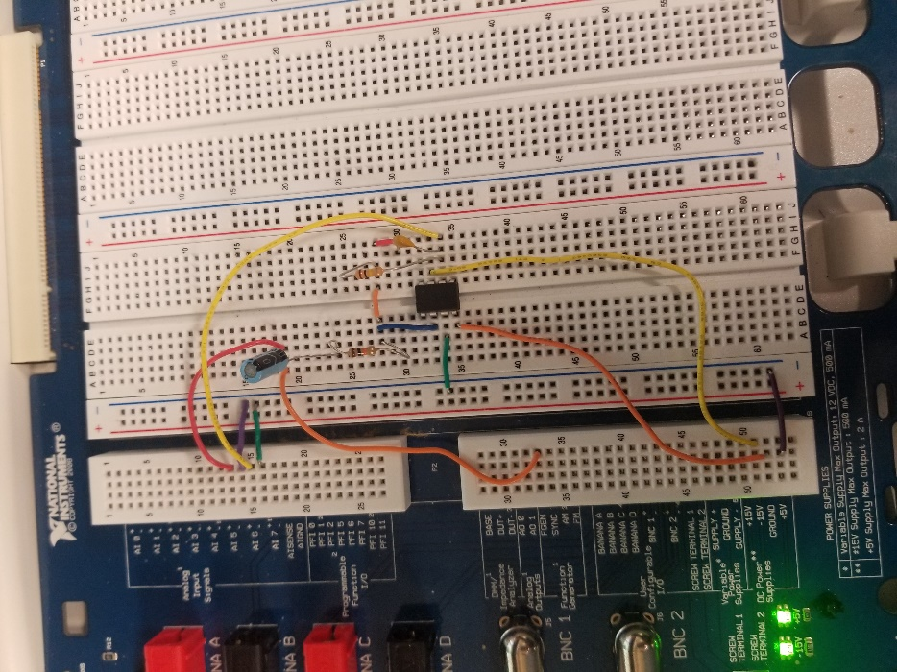
Op Amp Band Pass Filter
This is the picture of the circuit created from the schematic

Slide 64
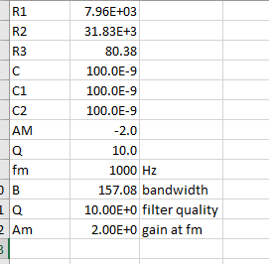
Op Amp Band Pass Filter
Spreadsheet
This is our spreadsheet calculations for the desired Filter

Slide 65
Op Amp Band Pass Filter
Observations: The band pas filter is a smooth signal tell it hits a certain frequency the gradually drops after hitting a certain frequency.

Slide 66
Op Amp High Pass Filter lab partners where Jarred Clark and Seth Wills
This Purpose of this lab is to build an Op Amp High Pass Filter while using elvis II and also using the functions for elvis II.
Equipment Needed:
Elvis II
10k ohm Resistor
100k ohm Resistor
1uf Capacitor
LM 741

Slide 67
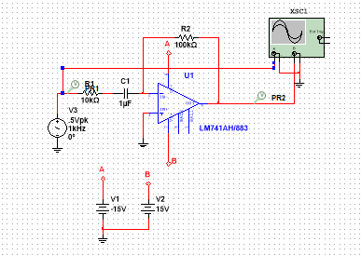
Op Amp High Pass Filter
This is our multisim schematic for the Op Amp High Pass Filter

Slide 68


Op Amp High Pass Filter
These are our pictures for the ac sweep and the bode analyzer readings for Elvis and Multisim

Slide 69

Op Amp High Pass Filter
This is the picture of the circuit created from the schematic

Slide 70
Op Amp High Pass Filter
Spreadsheet
This is our spreadsheet calculations for the desired Filter

Slide 71
Op Amp High Pass Filter
Observations: In an high pass filter. The filter is active at a high frequency and not active at a low frequency. That is why it is called a HIGH pass filter.

Slide 72
Op Amp Low Pass Filter lab partners where Jarred Clark and Seth Wills
This Purpose of this lab is to build an Op Amp Low Pass Filter while using elvis II and also using the functions for elvis II.
Equipment Needed:
Elvis II
10k ohm Resistor
100k ohm Resistor
1uf Capacitor
LM 741

Slide 73

Op Amp Low Pass Filter
This is our multisim schematic for the Op Amp Low Pass Filter

Slide 74


Op Amp Low Pass Filter
These are our pictures for the ac sweep and the bode analyzer readings for Elvis and Multisim

Slide 75

Op Amp Low Pass Filter
This is the picture of the circuit created from the schematic

Slide 76
Op Amp Low Pass Filter
Spreadsheet
This is our spreadsheet calculations for the desired Filter

Slide 77
Op Amp Low Pass Filter
Observations: In an low pass filter. The filter is active at a high frequency and not active at a low frequency. That is why it is called a low pass filter.

Slide 78
Op Amp Band reject or notch filter lab partners where Jarred Clark and Seth Wills
This Purpose of this lab is to build an Op Amp notch Pass Filter while using elvis II and also using the functions for elvis II.
Equipment Needed:
Elvis II
10k ohm Resistor
100k ohm Resistor
1uf Capacitor
.01uf Capacitor
LM 741

Slide 79

Op Amp Band reject or notch filter
This is our multisim schematic for the Op Amp Notch Filter

Slide 80


Op Amp Band reject or notch filter
These are our pictures for the ac sweep and the bode analyzer readings for Elvis and Multisim

Slide 81

Op Amp Band reject or notch filter
This is the picture of the circuit created from the schematic

Slide 82
Op Amp Band reject or notch filter
Spreadsheet
This is our spreadsheet calculations for the desired Filter

Slide 83
Op Amp Band reject or notch filter
Observations: The Op Amp band notch filter is a filter where it is active during certain frequency depending on the components that you have put into the circuit.

Slide 84
Fourier Series lab partners where Jarred Clark and Seth Wills
The purpose of this lab is to see how a full wave rectifier works and see the harmonics with a medium size capacitor, a bigger capacitor and no capacitor. Then compare the three.
Equipment needed:
Elvis II
2 – 1N4001 Diodes
1 – 10K resistor
1 – 1μF capacitor
1 – 10μF capacitor

Slide 85


Fourier Series
This is the multi-sim of the full wave rectifier using the 1N4001 diode
This is the oscilloscope reading of the multi-sim

Slide 86



Fourier Series
This the readings showing the frequency, magnitude and phase of each harmonic

Slide 87

Fourier Series
Spreadsheet
This is the excel of the readings on the previous slide

Slide 88


Fourier Series with a bigger capacitor

Slide 89

Fourier Series with no capacitor
This is the multi-sim of the full wave rectifier without a capacitor

Slide 90
Fourier Series
Observations: As the harmonics go up the phase and magnitude of the wave form decreases.

Slide 91


Butterworth Second Order Low Pass Filter My lab partners were Jarred Clark and Seth Wills
The purpose of this lab was to design, simulate and build a Butterworth second order low pass filter
Equipment needed:
2 – 10.23k ohm resistors
1- 44nF capacitor
1- 22nF capacitor
1 – 741 active filter
Elvis II
These are the coefficients we used for the out equation we used the numbers underneath the Butterworth section
This how we calculated the 2 resistor values

Slide 92


Butterworth Second Order Low Pass Filter
This is the multi-sim of our Butterworth low pass filter with the components values
This is the reading of our input (square wave) and the reading of our output (sine wave)

Slide 93



Butterworth Second Order Low Pass Filter
This is the multi-sim of our values and the equation and values that we had entered
Spreadsheet

Slide 94

Butterworth Second Order Low Pass Filter
This is the Fourier Analysis of our multi-sim of our Butterworth Second Order low pass filter

Slide 95

Butterworth Second Order Low Pass Filter
This is the reading of our built Butterworth second order low pass filter at 2kHz. You will notice when the square wave is at its peak the sine wave is at its low and when the square wave is at its low then the sine wave is at its peak.

Slide 96

Butterworth Second Order Low Pass Filter
This is our circuit for the Butterworth Second Order Low Pass Filter

Slide 97
Butterworth Second Order Low Pass Filter
Observations: When the input is at its peak then the filters output is at its low and when the input is at its low then the filters output is at its peak. This is because it is a low pass filter which a low pass filter works at a low frequency and when the frequency is high the filter “shuts off”.

Slide 98
Transformers My Lab Partners were Jarred Clark and Seth Wills
The purpose of this lab was to see how turn ratio effects the transfer. To do this we measured the resistance and voltage of a 24 VCT and 12.6 VCT transformer with a oscilloscope, multi-meter and a hand held multi-meter.
Equipment Needed:
1 – 12.6 VCT Transformer
1 – 24 VCT Transformer
Digital multi-meter
Hand Held multi-meter
Oscilloscope

Slide 99

Transformers
Spreadsheet
These are the readings that we got and put into excel of both transformers

Slide 100


Transformers
This is how we hooked up one of the transformers and then the primary resistance for the 24vct transformer

Slide 101

Transformers
This is the oscilloscope reading for measuring the output for one of the transformers

Slide 102
Transformers
Observations : The turns ratio of a transformer is based off of the ratio of the voltage that is inputted and the voltage that is outputted.

Slide 103
Inductors and Transformers My lab partners were Jarred Clark and Seth Wills
The purpose of this lab is to create inductors and transformers by using inductor cores and using magnet wire to add ten turns on each side to create a transformer and then place a 10k ohm load on the secondary and then apply an 100KHz 1pp sine wave to the primary and measure the primary and secondary voltages using an oscillioscope
Equipment needed:
4 inductor cores
Magnet wire
Tektronix TDS 220 Oscilloscope
Gwinstek Function Generator
10k ohm resistor
Alligator Clips

Slide 104

Inductors and Transformers
Spreadsheet
This is our spreadsheet that has the calculations for each inductor core including 10 turns on each side

Slide 105


Inductors and Transformers
This is us wrapping the inductor core around with magnet wired with ten turns on each sides and then the finished on the right side

Slide 106


Inductors and Transformers
This is one of the function generator and oscilloscope readings for one of the inductor cores and we could not get a clear sine wave without increasing the frequency

Slide 107


Inductors and Transformers
These are two of the inductor cores connected to the oscilloscope to enable to get the reading for the sine wave

Slide 108

Inductors and Transformers
This is a reading for the oscilloscope measuring a sine wave at 1 volt peak to peak

Slide 109
Inductors and Transformers
Observations: The winding of the wire is the turns on a transform. The bigger the core is the less inductance it has.

Slide 110
Datasheet

